Slide 1
Woodland School District College, Career, and Technical Education
CCTE
Where Community and Learning Connect

Slide 2
What is CCTE Course
A secondary course which has approved educational frameworks meeting content standards as well as leadership and employability standards
A course taught by a certified CCTE instructor
A course affiliated with a Career and Technical Student Organization (CTSO)
Identified Program of Work for students outside the academic day

Slide 3
What CCTE classes does Woodland traditionally have?
Agricultural Pathway
Business and Marketing
STEM (Science, Technology, Engineering, Math)
Family and Consumer Science Education

Slide 4
Agricultural Pathway Offerings
Animal Science
Agricultural mechanics – beginning and advanced
Beginning and advanced Metallurgy
Natural Resources
Middle School Future Trades
Middle School Mechanics
Middle School Floriculture/Horticulture
Floral Design and Flower Shop Management

Slide 5
Business and Marketing Pathway Offerings
Web Design I & II
Office Communications
Publishing
Entrepreneurship
Computer Applications
Personal Finance
Marketing I & II
Retail Operations

Slide 6
STEM Pathway
Woodworking I & II
Computer Aided Design (CAD)
Introduction to Woodworking – Middle School

Slide 7
FASCE Pathway
Life Skills
Creative Chef I
Creative Chef II
Early Childhood I
Early Childhood II
Careers in Education

Slide 8
What do these kids do?

Slide 9
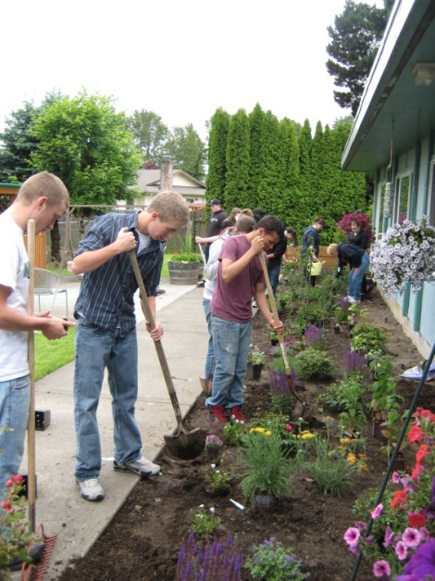
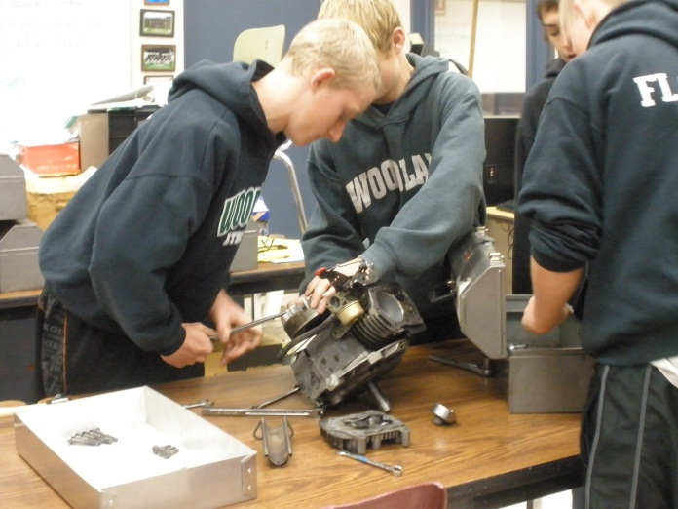
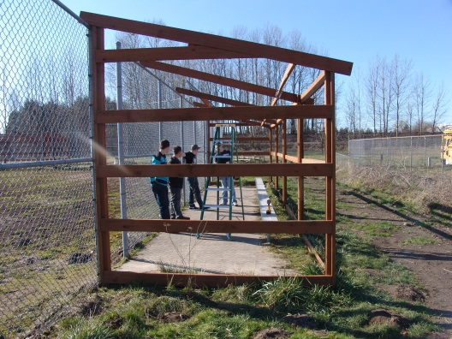
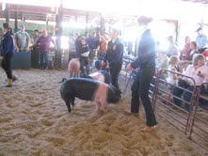
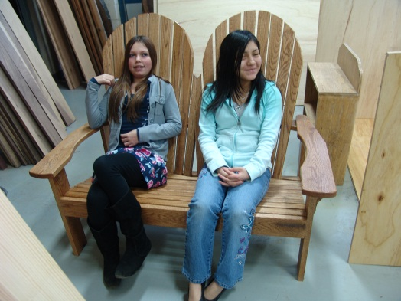
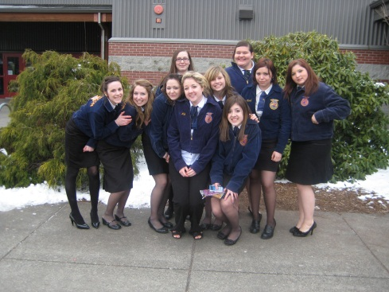
Future Farmers of America (FFA)
Agricultural and STEM Pathways CTSO

Slide 10
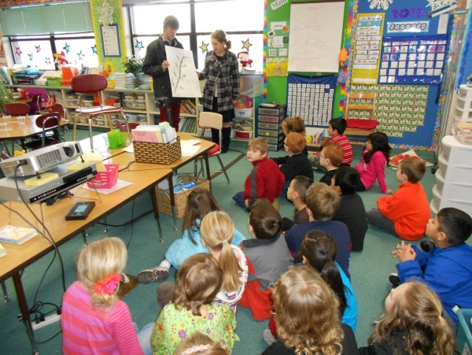
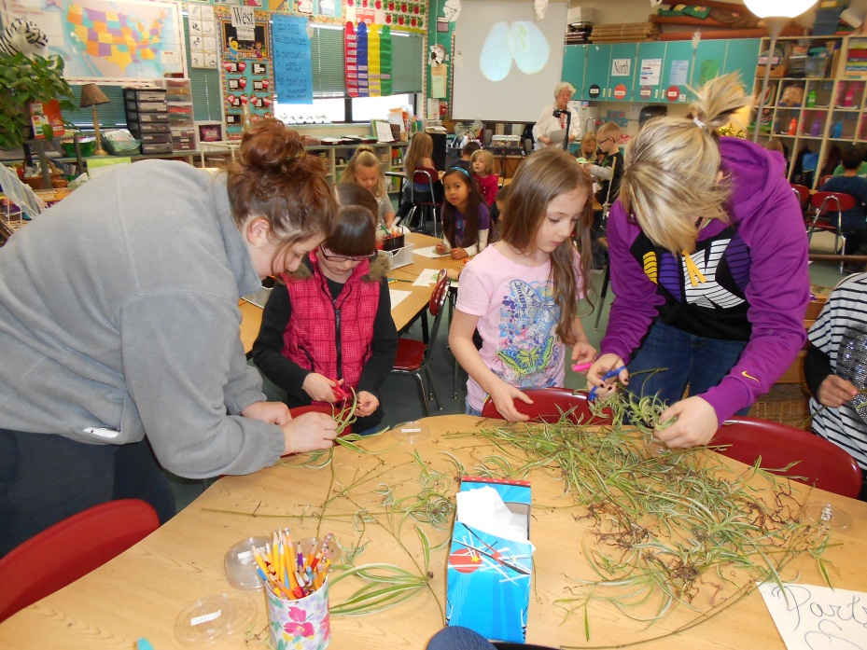
Early Childhood Education (FASCE Pathway)
Family, Career, and Community Leaders of America (FCCLA) CTSO

Slide 11
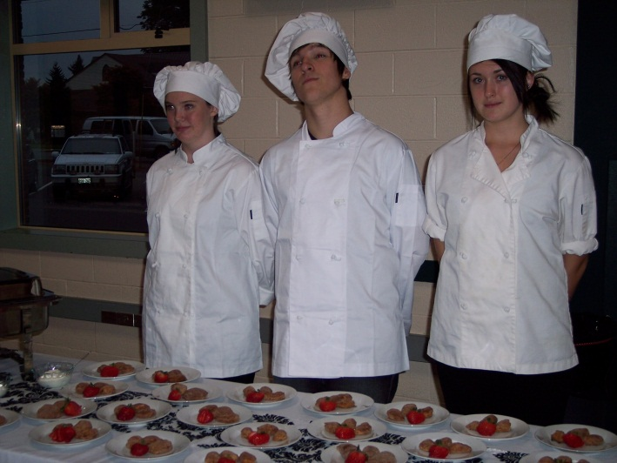
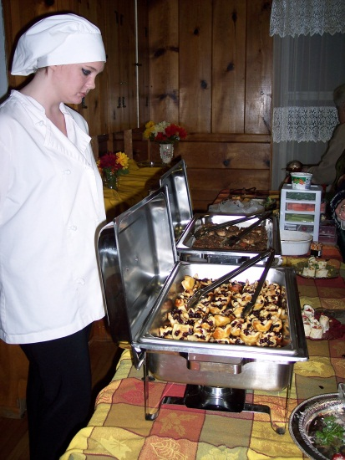
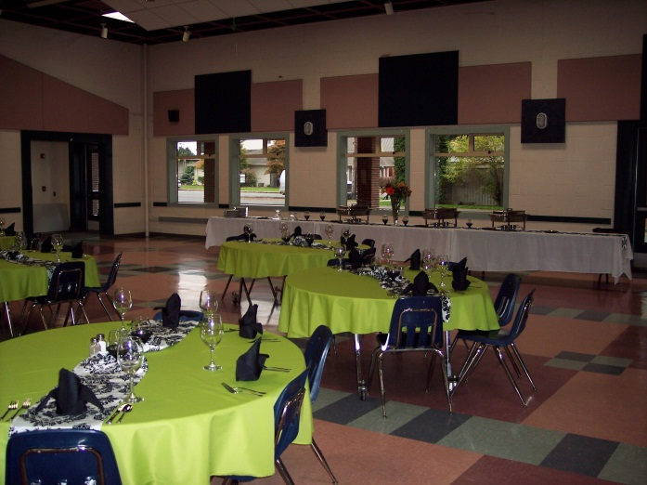
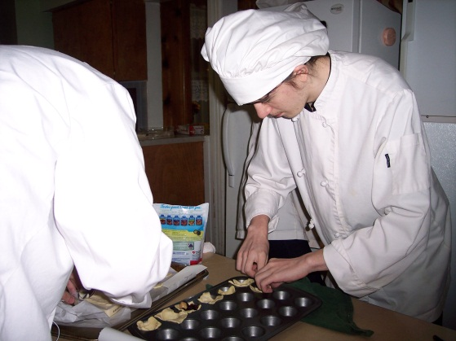
Creative Chef I & II (FASCE Pathway)
Skills USA CTSO

Slide 12
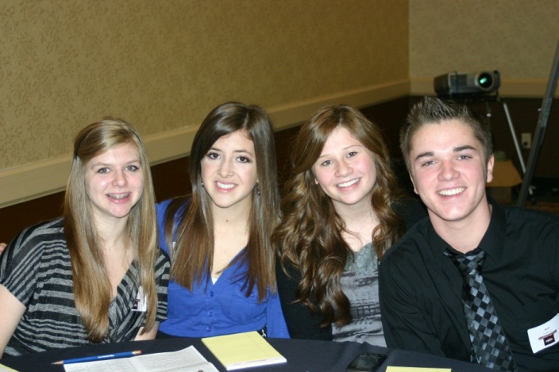
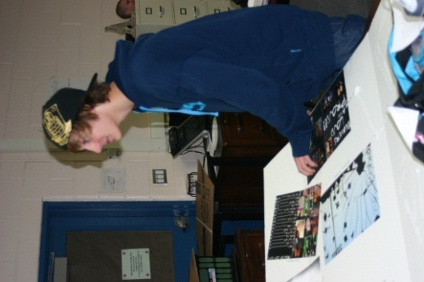
Business and Marketing Pathway
Future Business Leaders of America (FBLA) CTSO

Slide 13
Current Tech Prep Courses
WHS CTE Course
Community College Course
Computer Applications
Computer Applications
Web Design
Entrepreneurship
Beginning Metallurgy
Advanced Metallurgy
Beginning Mechanics
Advanced Mechanics
Intro. to Business Tech.
Web Design
Entrepreneurship
Intro. to Oxy-acetylene
Intro. To Arc Welding
Intro. to small engines
Essentials of Mechanics

Slide 14
Current Tech Prep Courses Cont.
WHS CTE Course
Community College Course
Early Childhood I
Early Childhood I
Early Childhood I
CAD
CAD
CAD
Introduction to Early Childhood
Child Development
Practicum I
Technical Drawing
Introduction to Drafting
Drafting

Slide 15
Current Industry Certifications
Microsoft Office Specialist (MOS)
Bronze Certified Technician (STIHL)
Food Handler’s Card
CPR
First Aid

Slide 16
Current Cross-Credited Courses
WHS CCTE Class
Cross-Credited Class
WHS Publications
Web Design II
Early Childhood I
Art
Art
Health

Slide 17
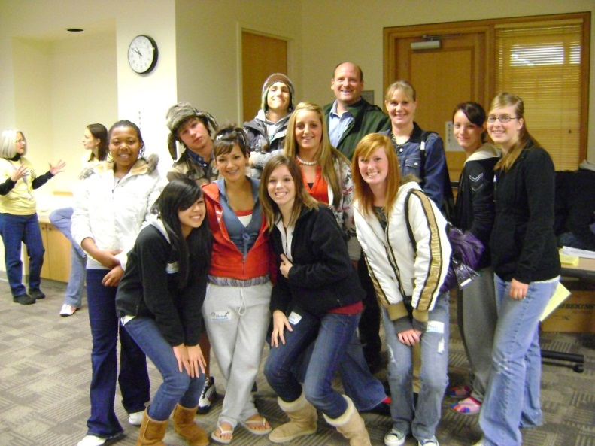
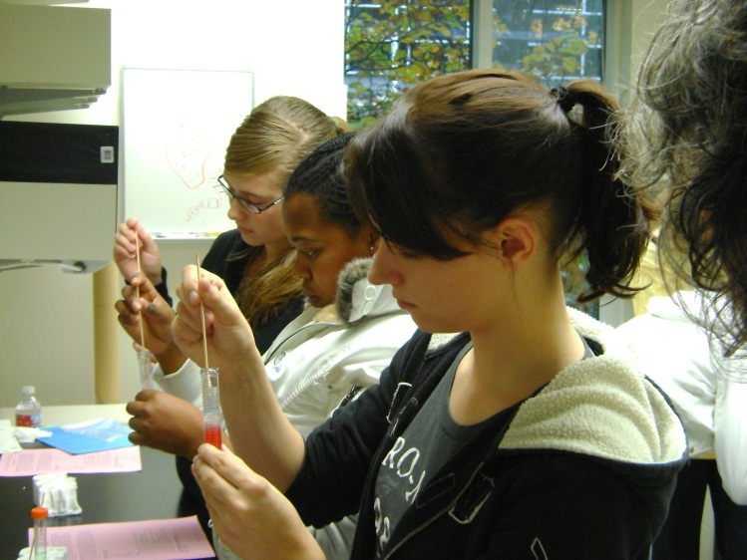
New for Next Year Health Sciences
Advanced Placement Biology
Anatomy and Physiology
Health Occupation Students of America (HOSA)- CTSO

Slide 18
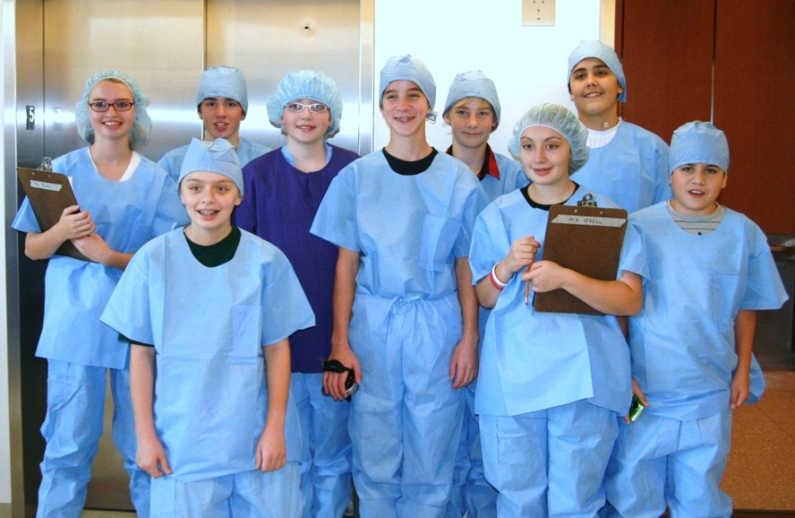
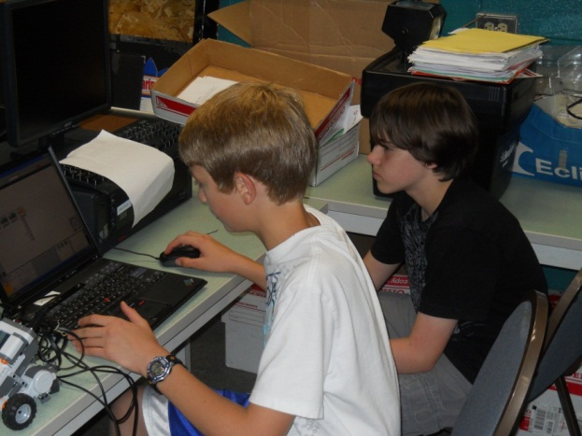
STEM Additions
Lego Robotics
First Tech Challenge
Technology Students of America (TSA) – CTSO

Slide 19
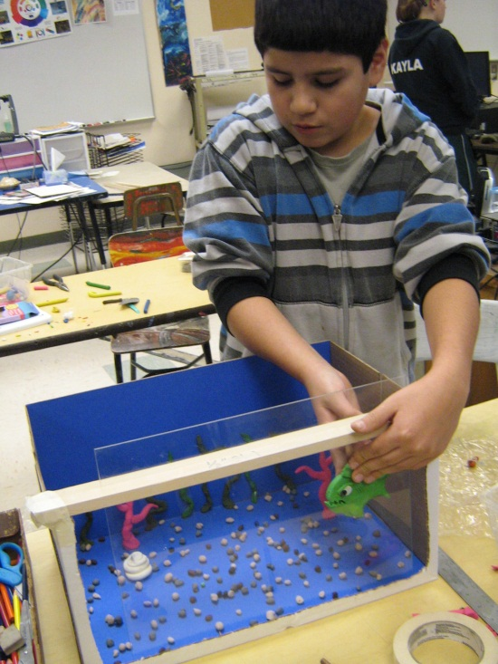
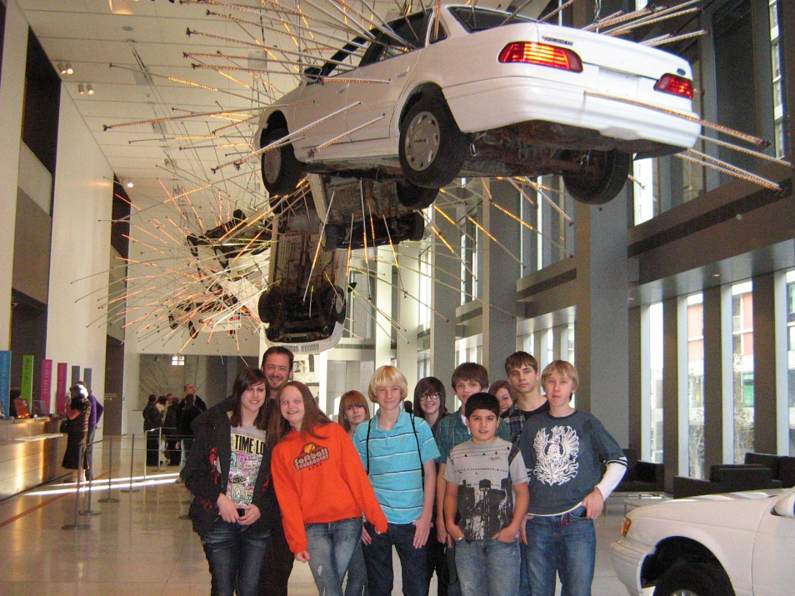
Audio and Video Technology Pathway
WMS Publications
WHS Photography
FBLA or TSA - CTSOs

Slide 20
North County Applied Math
Funded by the Skills Center – Joint CTE and Math

